Slide 1
Introduction to Reinforcement Learning
Dr. Prashant Aparajeya

Slide 2
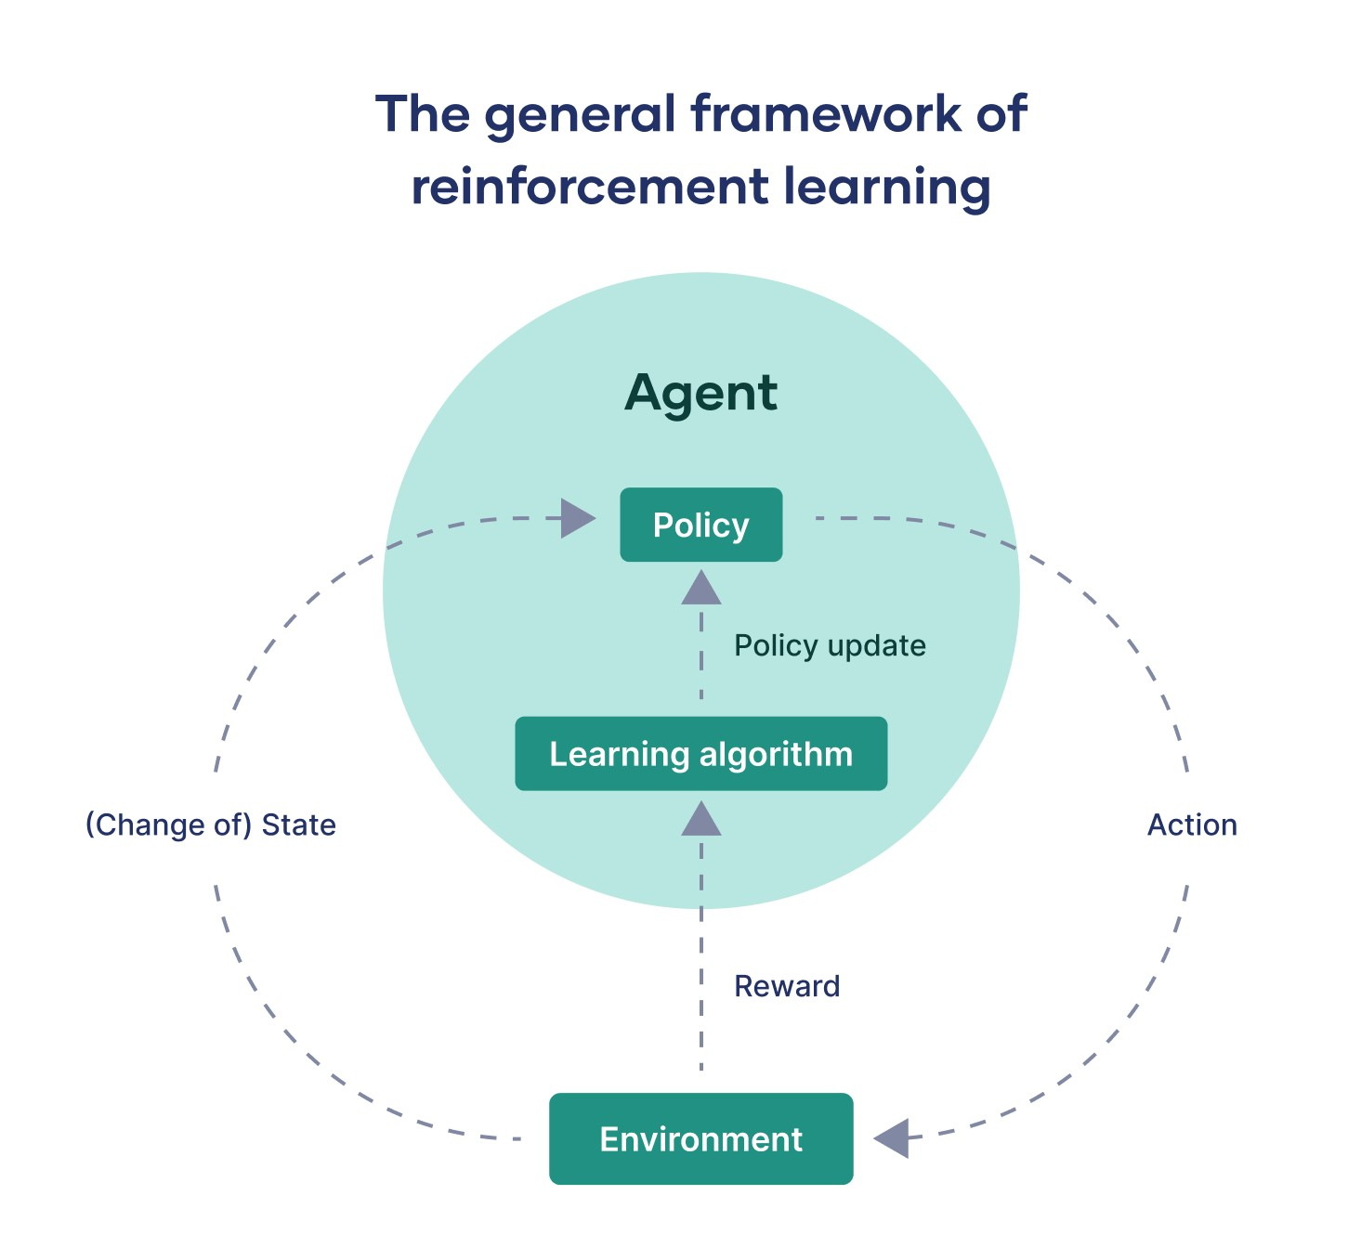
Policy

Slide 3
What is a Policy in Reinforcement Learning?
A policy is the agent’s strategy for choosing actions.

Slide 4
What is a Policy in Reinforcement Learning?
A policy is the agent’s strategy for choosing actions.
Denoted by 𝜋(a∣s), which means:
The probability of taking action a in state s under policy 𝜋.

Slide 5
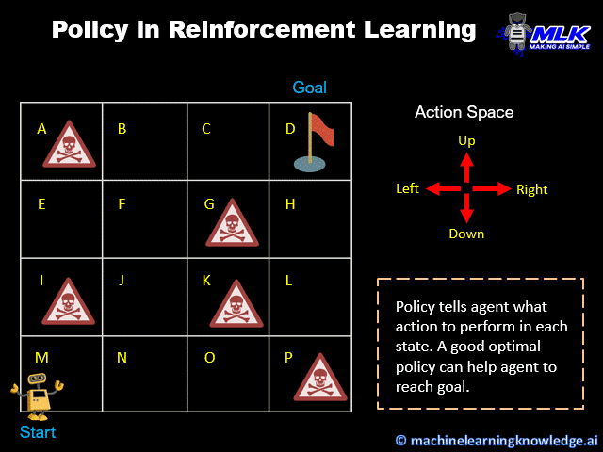

Slide 6
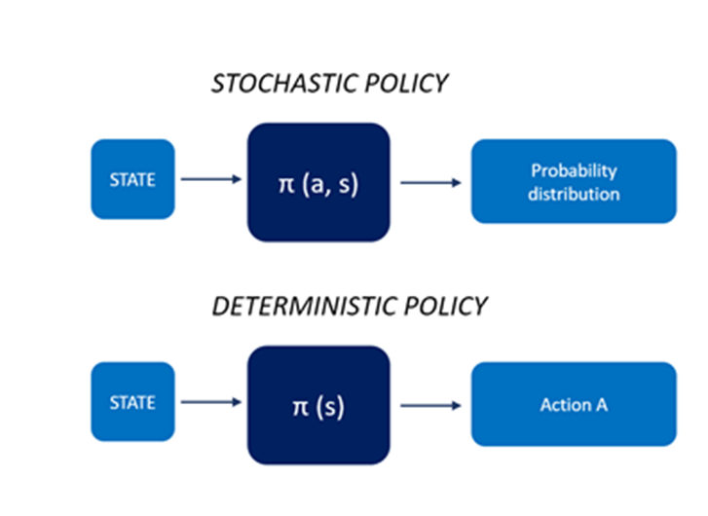
What is a Policy in Reinforcement Learning?
There are two main types:
Deterministic Policy: Always picks the same action for a state.
Example: 𝜋(s)=a1
Stochastic Policy: Assigns probabilities to different actions.
Example: 𝜋(a1∣s)=0.7, 𝜋(a2∣s)=0.3

Slide 7
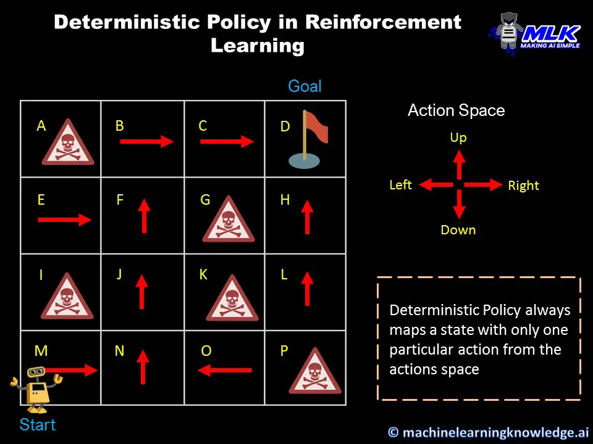

Slide 8
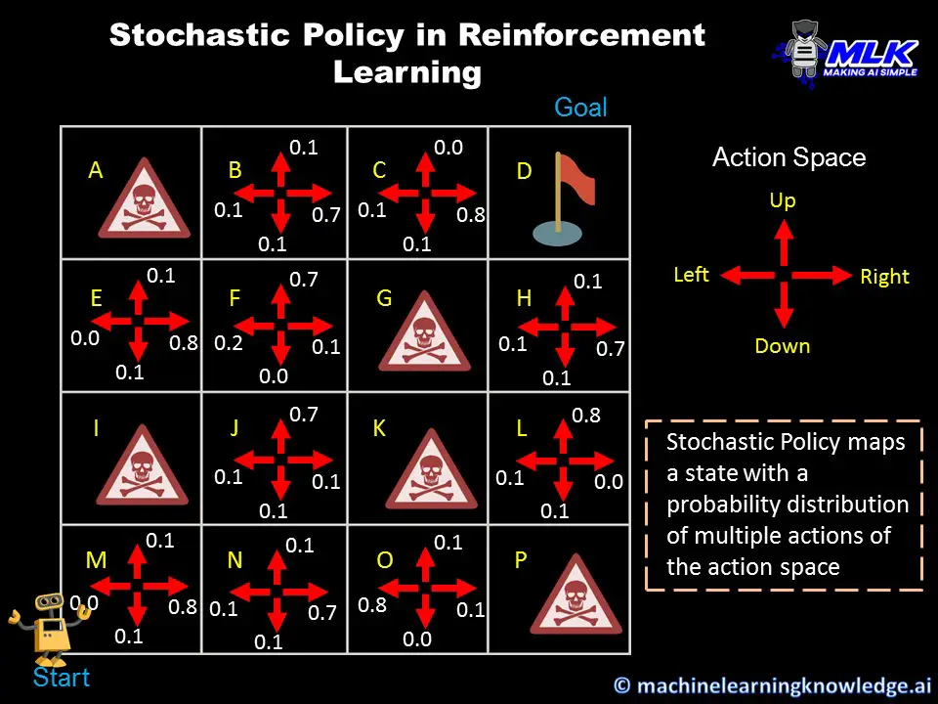

Slide 9
What is the Optimal Policy?
The optimal policy 𝜋∗ is the one that gives the highest possible expected return from every state.

Slide 10
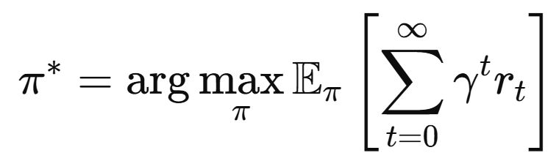
What is the Optimal Policy?
The optimal policy 𝜋∗ is the one that gives the highest possible expected return from every state.
Formally:
This means:
Among all possible strategies, the optimal policy is the one that maximizes the expected sum of discounted rewards over time.

Slide 11
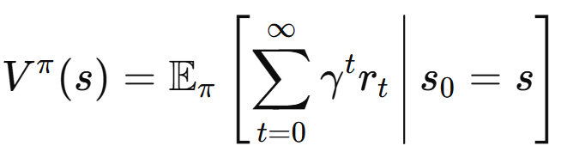
What is the Expected Sum of Rewards?
The expected sum of rewards (also called the expected return) from a state 𝑠 under a policy 𝜋 is:
: Value of state 𝑠 under a policy 𝜋
It’s the expected (average) total discounted reward the agent gets by starting in state 𝑠 and following policy 𝜋.

Slide 12
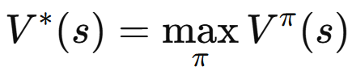
What is the Maximum of Expected Sum of Rewards?
That’s the value under the optimal policy:
This is the maximum achievable expected return from state 𝑠.
So if you follow the best possible policy, this is the most reward you can expect from state 𝑠.

Slide 13
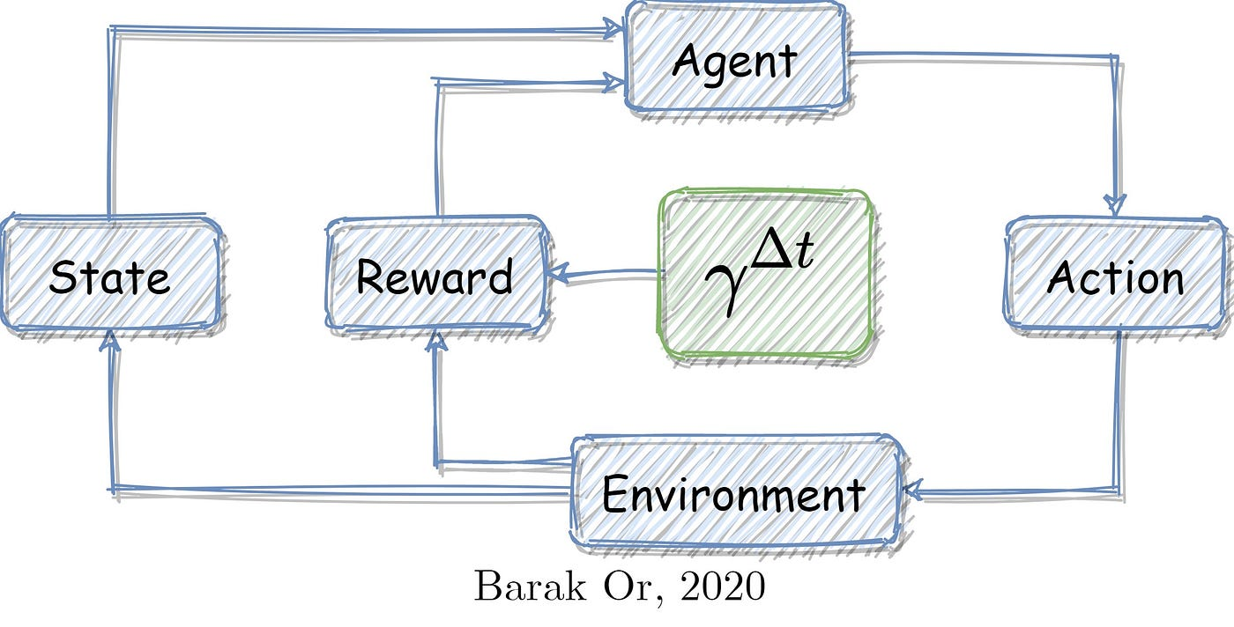
Discount

Slide 14
What is Discount in Reinforcement Learning?
The discount factor, denoted by γ (gamma), is a number between 0 and 1:
It determines how much importance the agent gives to future rewards compared to immediate rewards.
A higher γ (close to 1) means long-term rewards are important.
A lower γ (close to 0) means the agent is short-sighted and prefers immediate rewards.

Slide 15
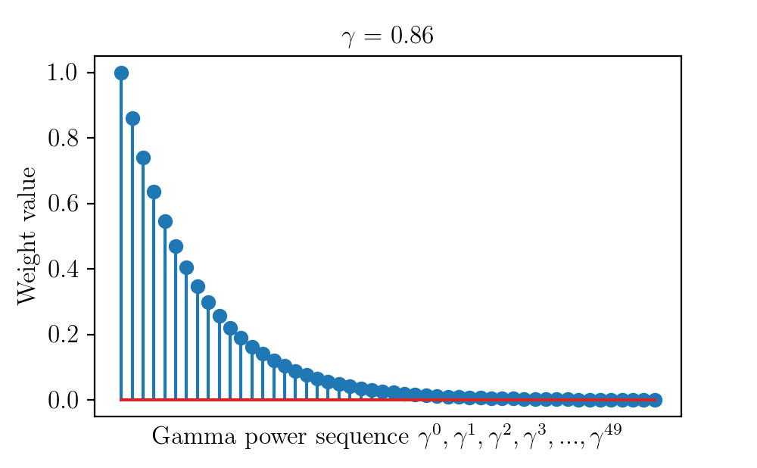

Slide 16
Why is Discounting Needed?
Time Preference: In real life, rewards now are often more valuable than rewards later (e.g., $100 today vs. $100 next year).
Uncertainty: Future is uncertain — rewards may or may not be obtained.
Mathematical Convergence: It ensures that infinite reward sequences have finite total values.

Slide 17
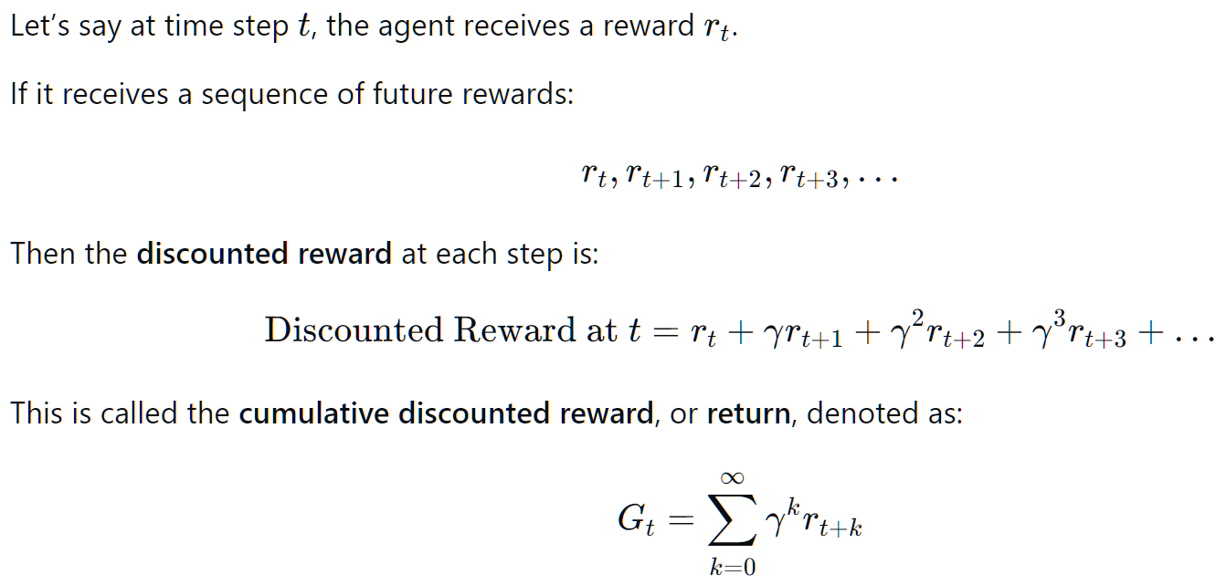
What is Discounted Reward?

Slide 18
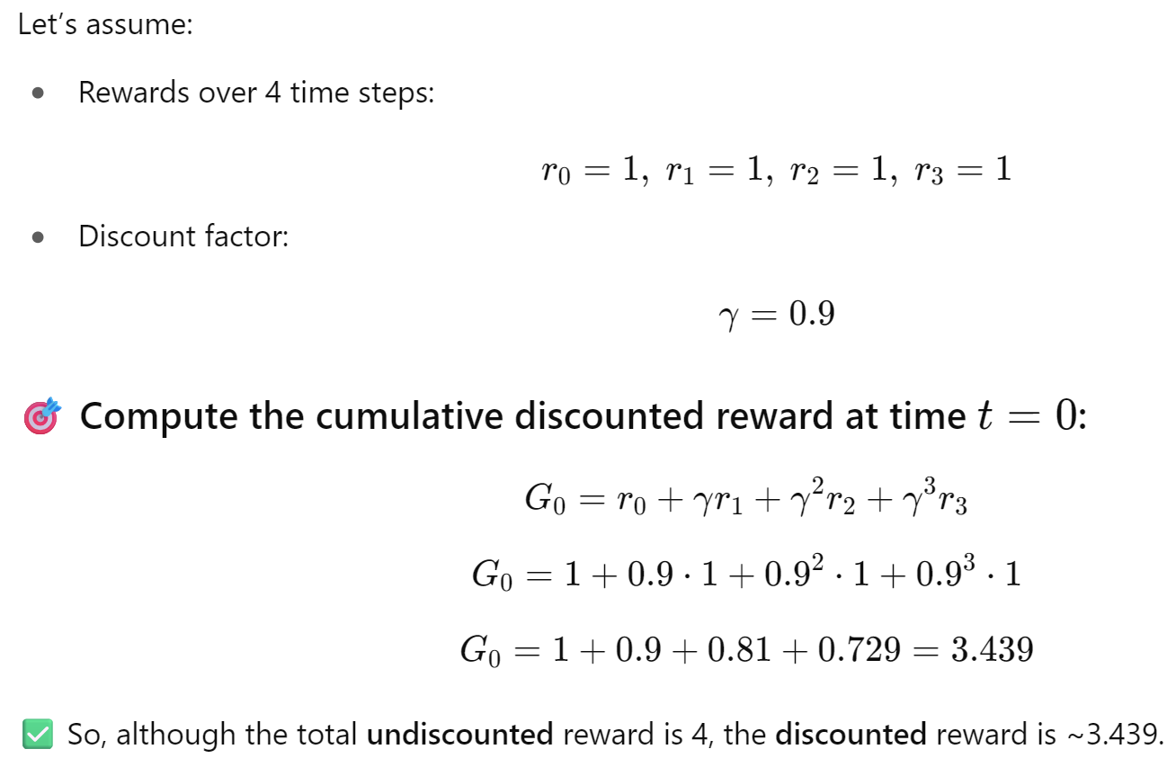
Example 1: Simple Scenario

Slide 19
Q-Value Function

Slide 20
What is the Q-Value Function?
The Q-value function (also called Action-Value function) tells you:
“If I start from state s, take action a, and then follow a policy π, what’s the expected total reward I’ll get?”

Slide 21
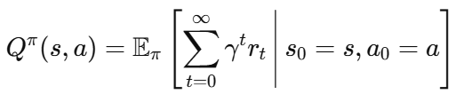
What is the Q-Value Function?
Formally, under policy 𝜋:
Where:
s = current state
a = action taken in state s
γ = discount factor
rt​ = reward at time step t

Slide 22
Why Use the Q-Function?
The Q-function allows the agent to:
Compare actions within the same state.
Choose the best action without needing a full model of the environment.
Learn from trial-and-error.

Slide 23
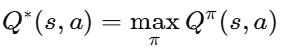
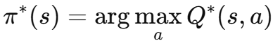
Why Use the Q-Function?
If the agent learns the optimal Q-function:
Then the optimal policy is simply:
That means: “At every state, just choose the action with the highest Q-value.”

Slide 24
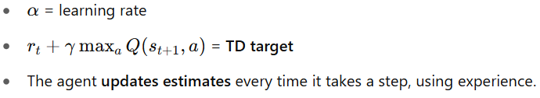
How Does the Agent Learn Q-Values?
Via Q-Learning, which uses this update rule:

Slide 25
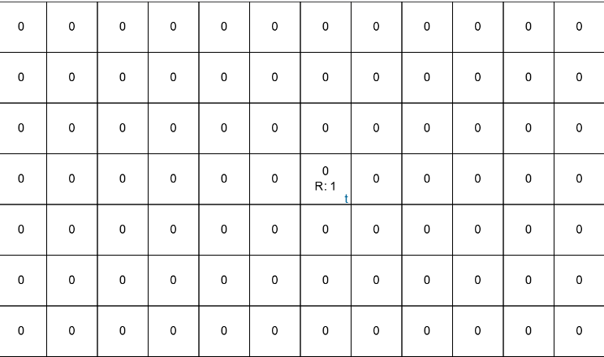

Slide 26
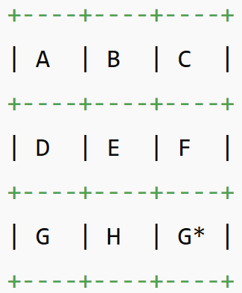
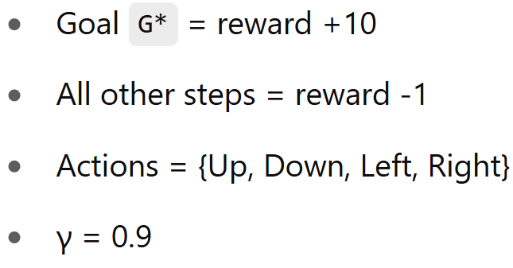
Example: Gridworld 3x3

Slide 27
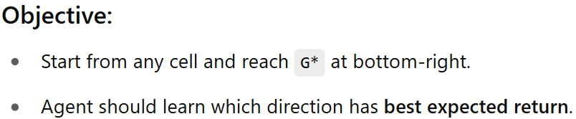
Example: Gridworld 3x3

Slide 28
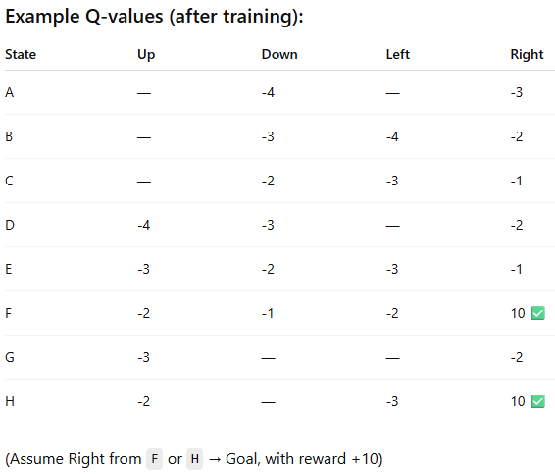

Slide 29
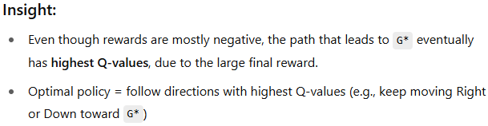
Example: Gridworld 3x3

Slide 30
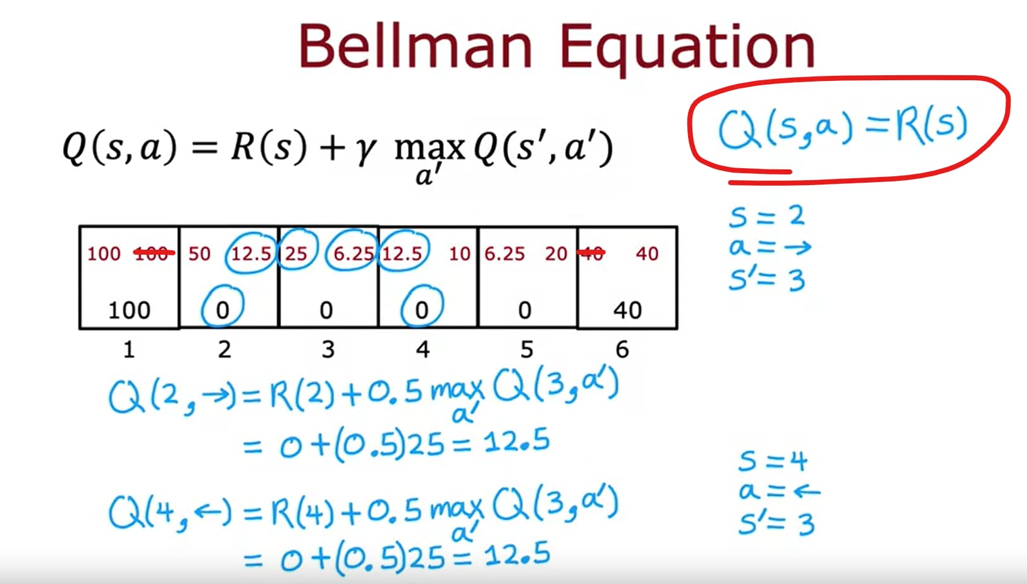
Bellman Equation

Slide 31
What is the Bellman Equation?
The Bellman Equation expresses a recursive relationship between the value of a state and the value of its successor states.
“The value of a state is the immediate reward plus the value of the next state.”

Slide 32
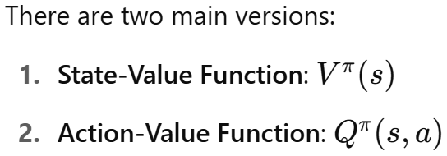
What is the Bellman Equation?

Slide 33
Bellman Equation for State-Value Function:
For a given policy π:
“Value of a state = expected reward for taking an action + expected discounted value of the next state.”

Slide 34
Bellman Equation for Q-Value Function
This tells you how good it is to take action 𝑎 in state 𝑠 and then follow policy 𝜋.

Slide 35
Bellman Equation: Intuition and Inspiration
Where Did It Come From?
The Bellman equation was introduced by Richard Bellman in the 1950s as part of his work on Dynamic Programming.
Bellman's key idea: break a problem into smaller subproblems — solve them recursively — a principle called "Bellman's Principle of Optimality."
He used it in:
Operations research
Economics (e.g., dynamic resource allocation)
Control theory
Later, RL researchers adapted it to stochastic environments where outcomes are uncertain — and that's the modern form of the Bellman equation used in RL.

Slide 36
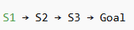
Scenario: State Linear MDP with Discounting
We have 4 states in a line:

Slide 37
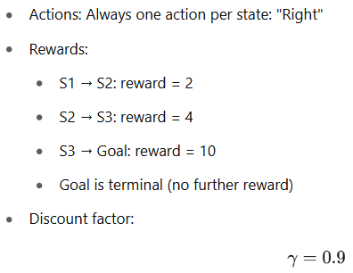
Scenario: State Linear MDP with Discounting
We have 4 states in a line:

Slide 38
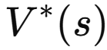
Objective
Use the Bellman equation to compute the state-value function
for each state using optimal policy, assuming agent always moves "Right".
We’ll solve step-by-step, going backward from the Goal.

Slide 39
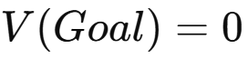
Step 1: Set Terminal Value
(Once we reach the terminal state, no further rewards)

Slide 40
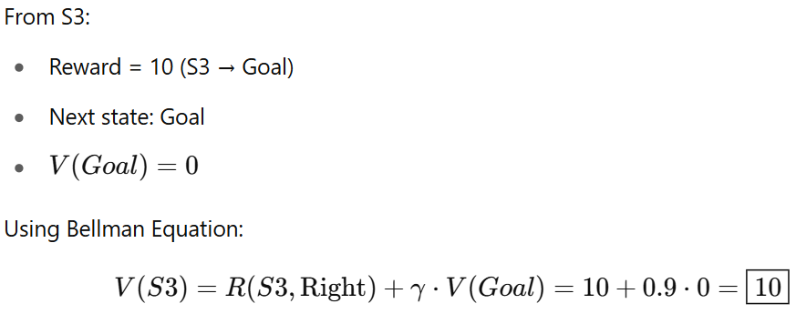
Step 2: Compute 𝑉(𝑆3)

Slide 41
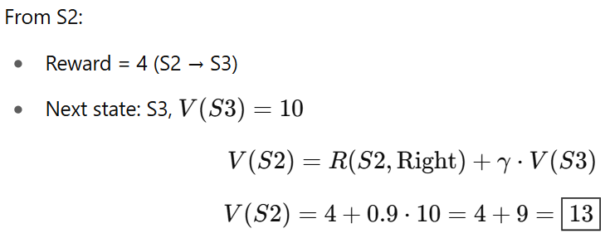
Step 2: Compute 𝑉(𝑆2)

Slide 42
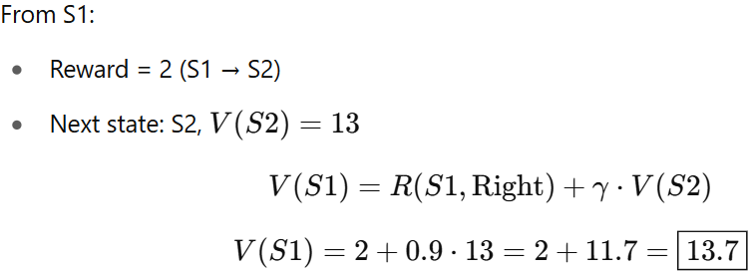
Step 2: Compute 𝑉(𝑆1)

Slide 43
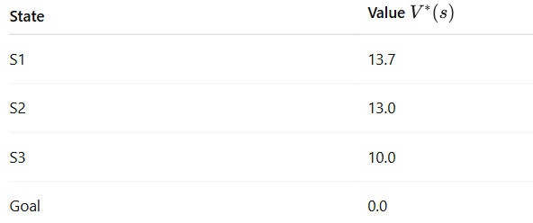
Final State Values

Slide 44
Let's Interpret This
Even though the reward at S1 is only 2, its value is high (13.7) because it leads to S2 and then S3, which offer bigger future rewards.
The discount factor 𝛾=0.9 means future rewards are valuable, but slightly less than immediate rewards.
This reflects Bellman’s principle: the value of a state is the reward now + value of the future, discounted appropriately.

Slide 45
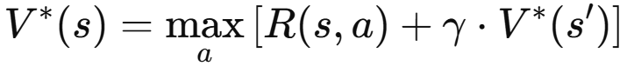
Bellman Equation Used at Each Step
In this case, there's only one action ("Right") per state, so the max is trivial.

Slide 46
Recap

Slide 47
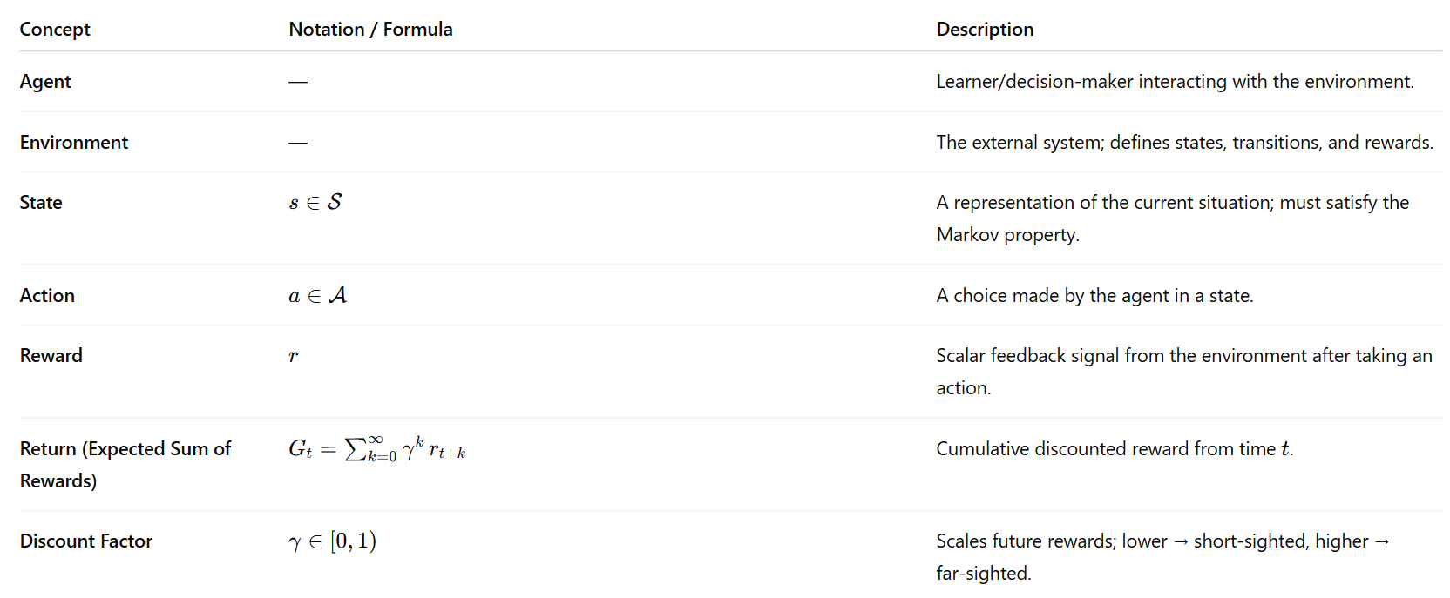

Slide 48
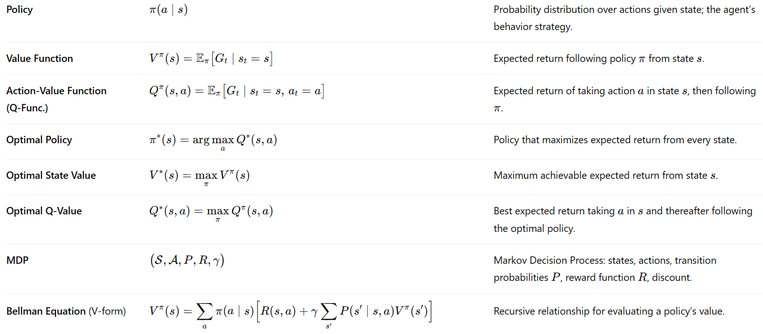

Slide 49
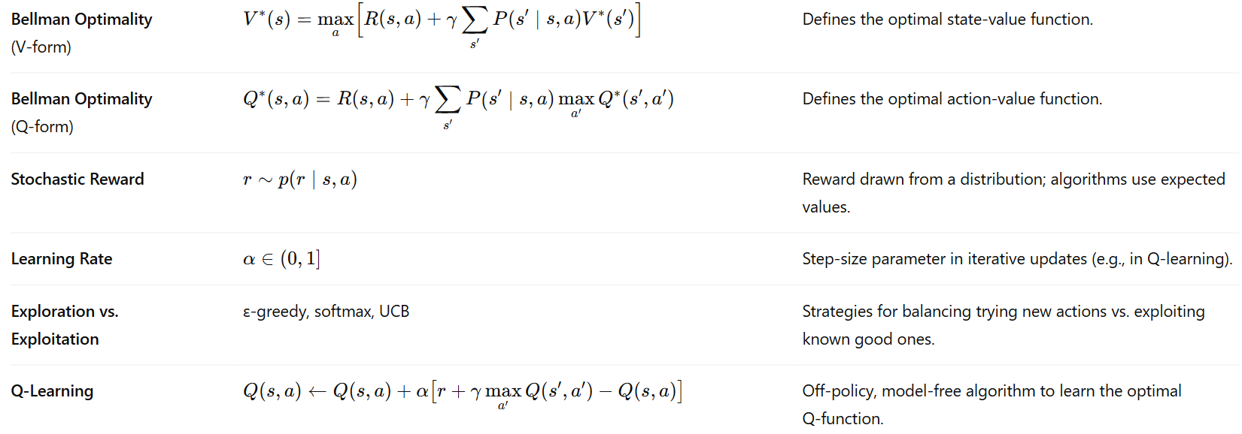

Slide 50
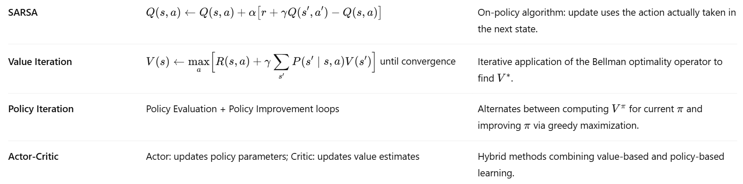

Slide 51
